Slide 1
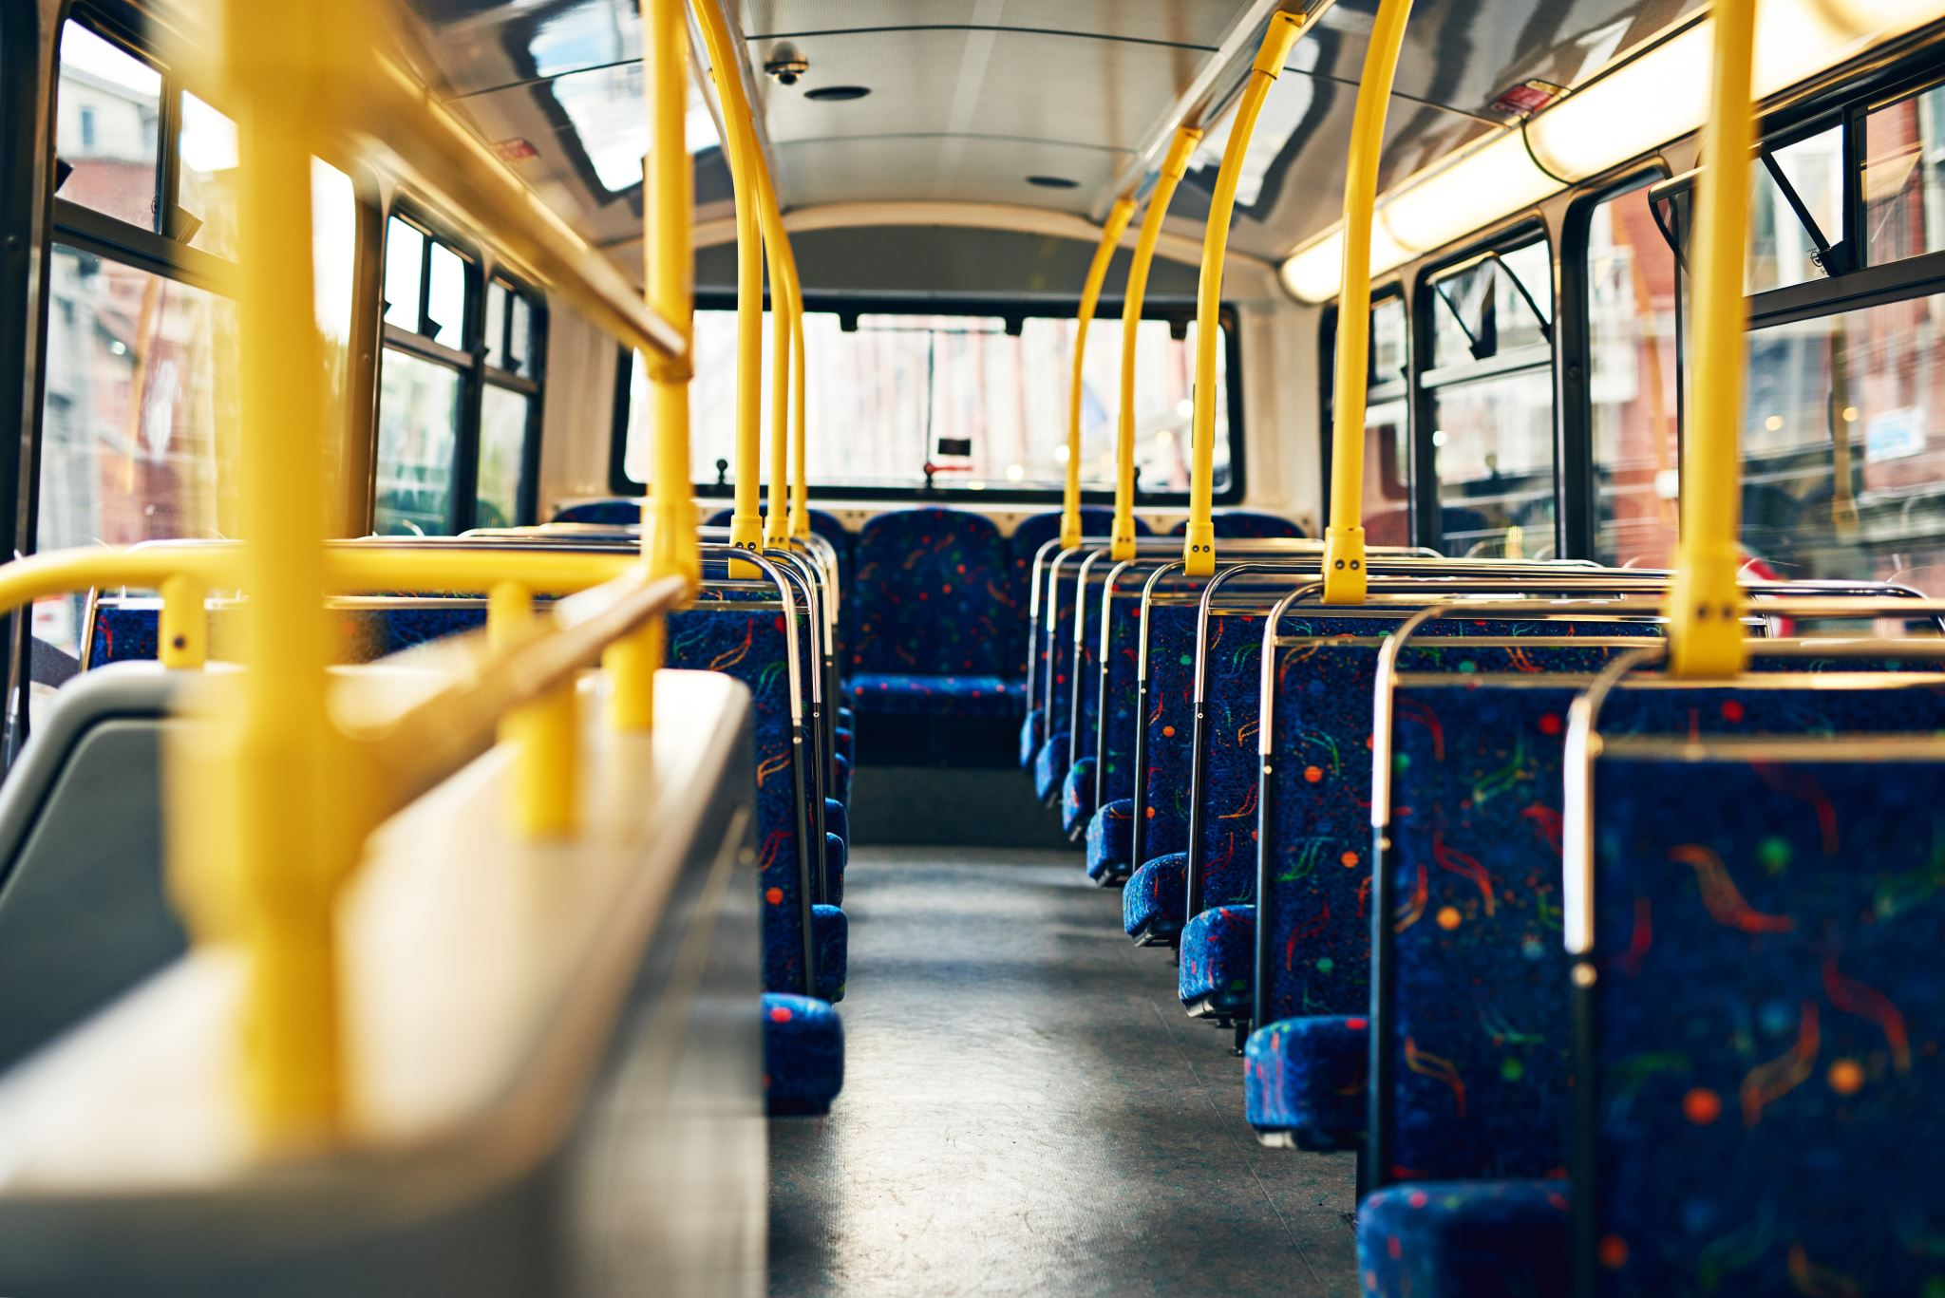
‘Bus Delay’ Business Report

Slide 2
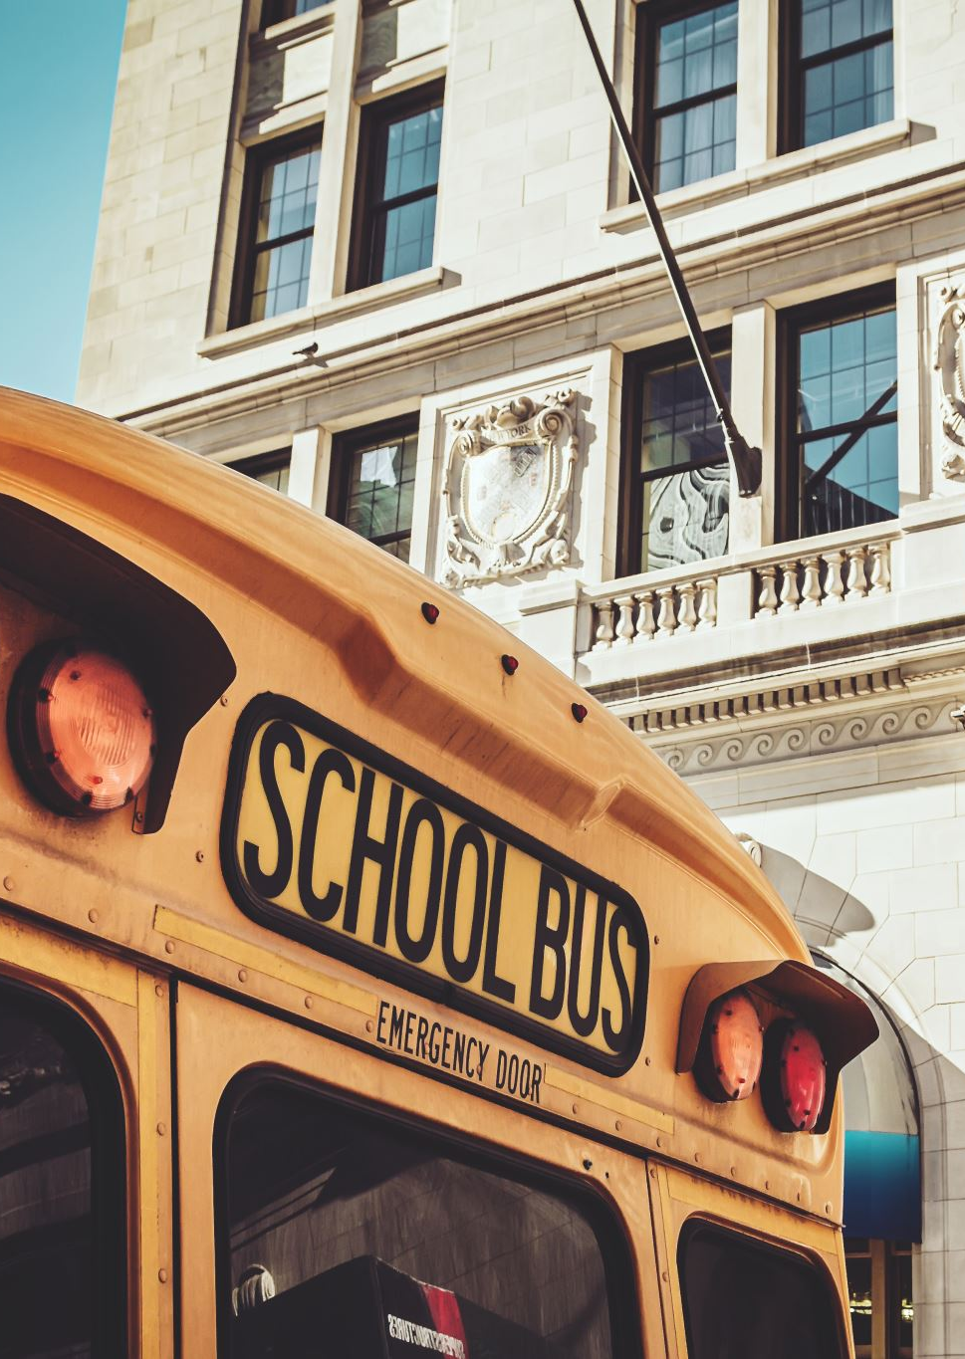
Key Stakeholders
OPT (Office of Pupil Transportation) by New York City Department of Education.
Parents & Guardians
Bus Vendors
School Administrations

Slide 3
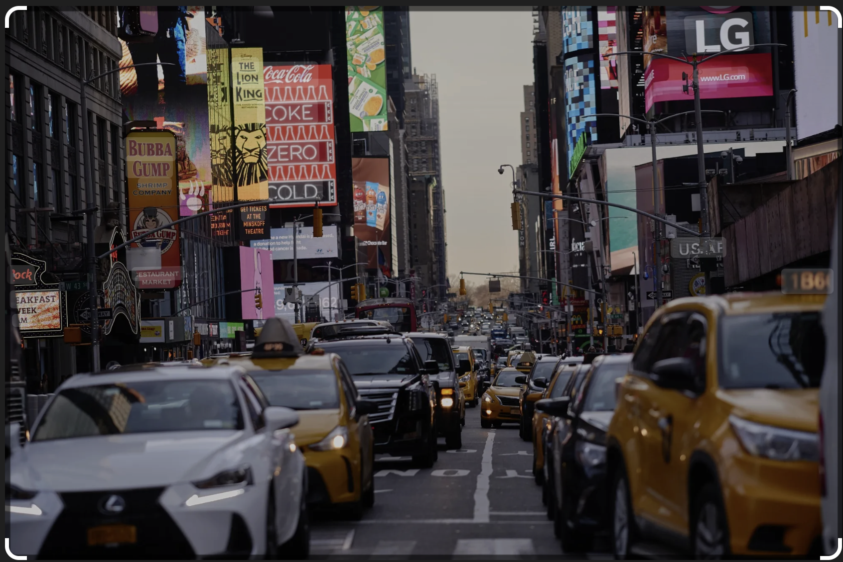
Bus Delay Journey
Scenario 1 Imagine a busy New York weekday…….. a corporate passionate employee all ready to leave for his/her office, a retail store worker hustling to make to his store before customer’s start showing up, all the health coach and fitness freak driving those vehicles to hit gym before it gets too crowded and some college students who got over friendly today and thought to catch up at that far corner café for a morning coffee… and amidst all these chaos is also stuck a school bus trying its best to reach school premises on time, carrying educational and safety responsibility of countable but bus full of young lives.

Slide 4
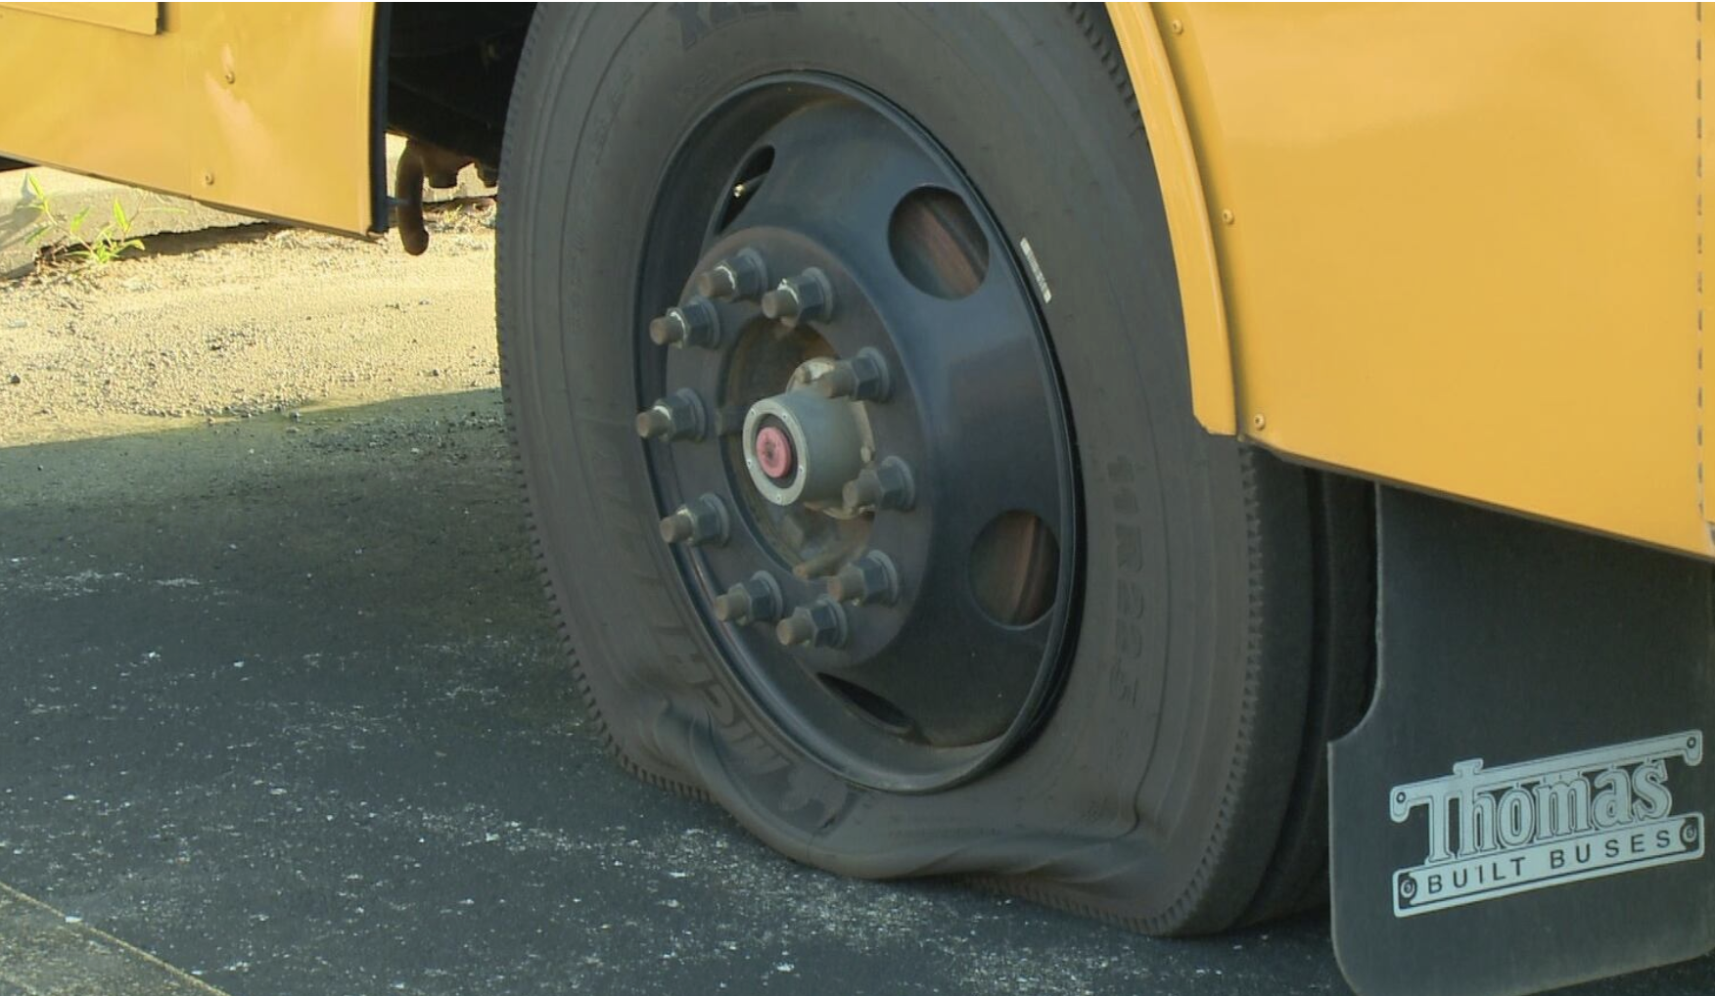
Bus Delay Journey
Scenario 2 Now Imagine another New York suburb weekday during winter mornings with light rain…….. Everything remains same like any other weekday, except this time the traffic is less because of freezing rain and dark cloud covering the sky. The school bus is still hustling to make in time, carrying children from curbside during such harsh winters, the traffic issue is gone because the roads are empty… and there comes another problem ….. FLAT TIRE

Slide 5
Understanding the Business Problem
From the previous 2 case scenarios we understand, how crucial it is to track the movement of these school buses by each and every stakeholder. Another important fact that can be safely said from the previous 2 slides are, there can be several factors contributing to bus delays which may or may not be within human control. Therefore, it is necessary to understand/predict what can be average delay in a particular route, and any delay lying beyond this zone might need joint intervention of OPT and Bus Vendors. This analysis isn’t just numbers- it’s about answering all those families who are waiting at home and helping all those bus vendors who cannot improve working efficiency because of no analysis.

Slide 6
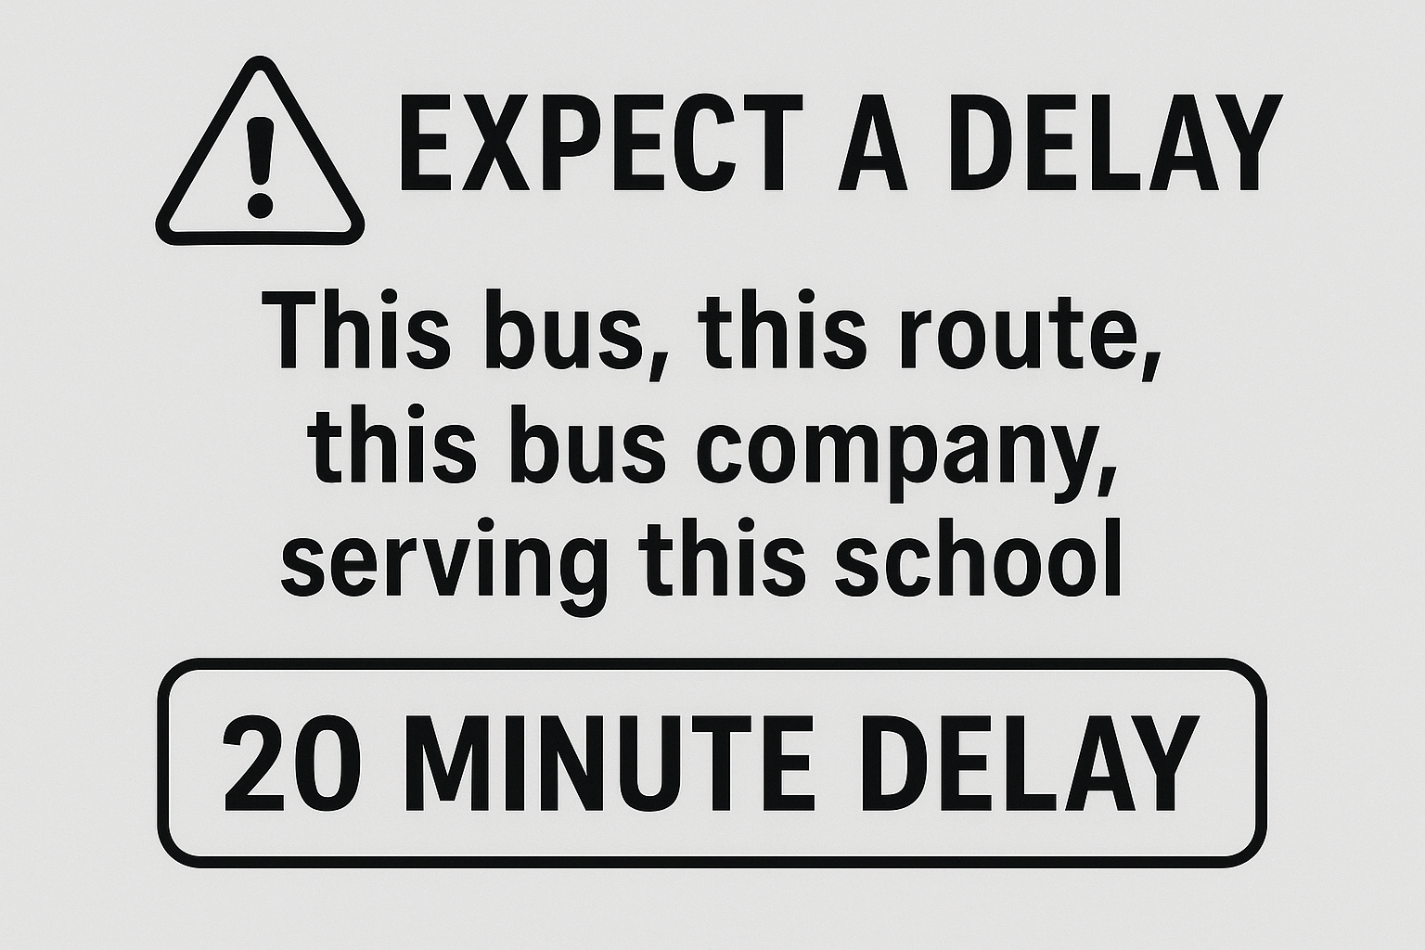
Formulating Business Problem
Making a Delay-Forecasting System – using real time traffic and weather data to exactly predict route delays, find alternative routes and send backup vehicles wherever necessary, along with timely alerting parents.
Imagine it like a ‘Delay-Radar’ system: This bus, this route, this bus company, serving this school – expect a 20 minute delay.

Slide 7
What Data Told Soo Far ?!
Before digging into these reports, it was necessary to make sure that all the information are useful, reliable and organized, as any wrong information can lead to bad decision making. Arranging these reports in usable pattern was similar to organizing a messy cabinet. To better understand this project and the amount of resources required to complete it, we decided to give it a skim-read. The numbers indicated a lot of inconsistencies, for example someone was maintaining a daily diary and suddenly skipped couple of days leaving the audience in suspense as to what might have happened. So to make the daily diary (our bus data) more consistent we tried filling the gaps, but whenever the missing records turned from days to year’s we decided not to create synthetic story points and moved into analyzing another year. The intent behind doing this ‘find and fill’ method was simple, we wanted to look at yearly trends, repetitive patterns, any bus vendor facing same mechanical issues etc.

Slide 8
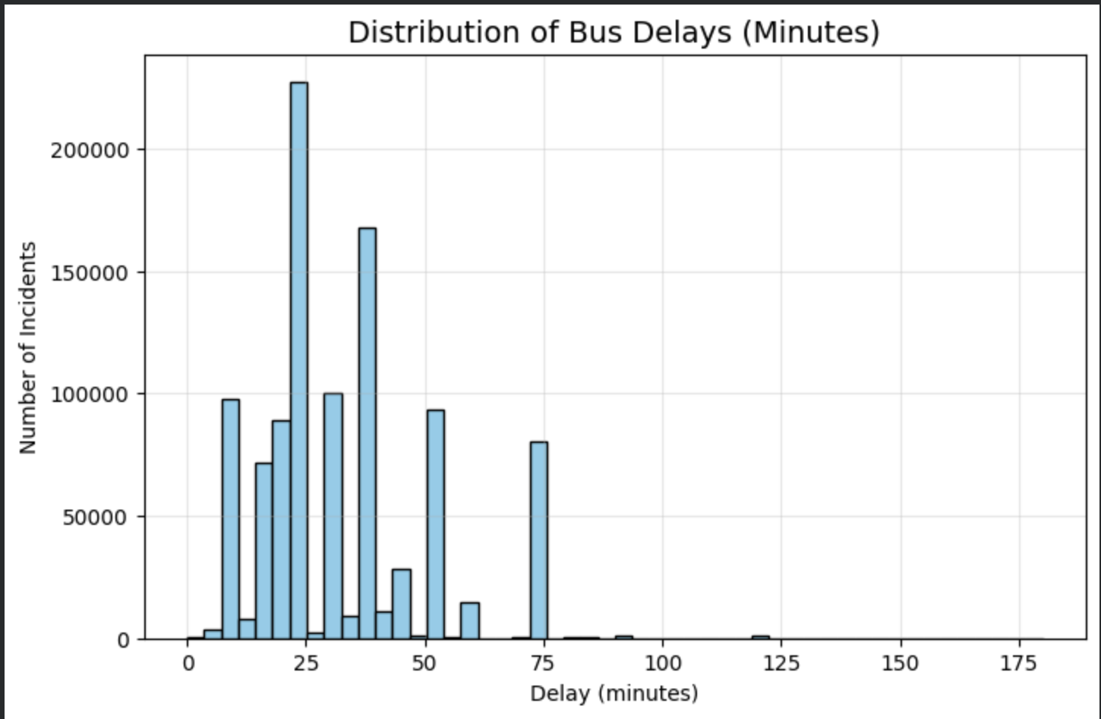
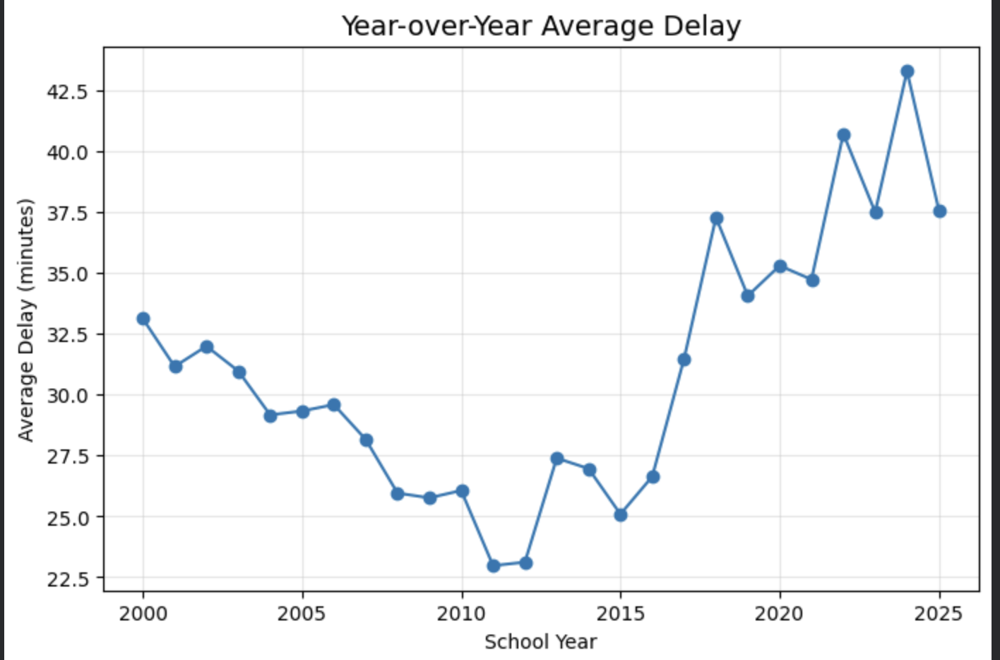
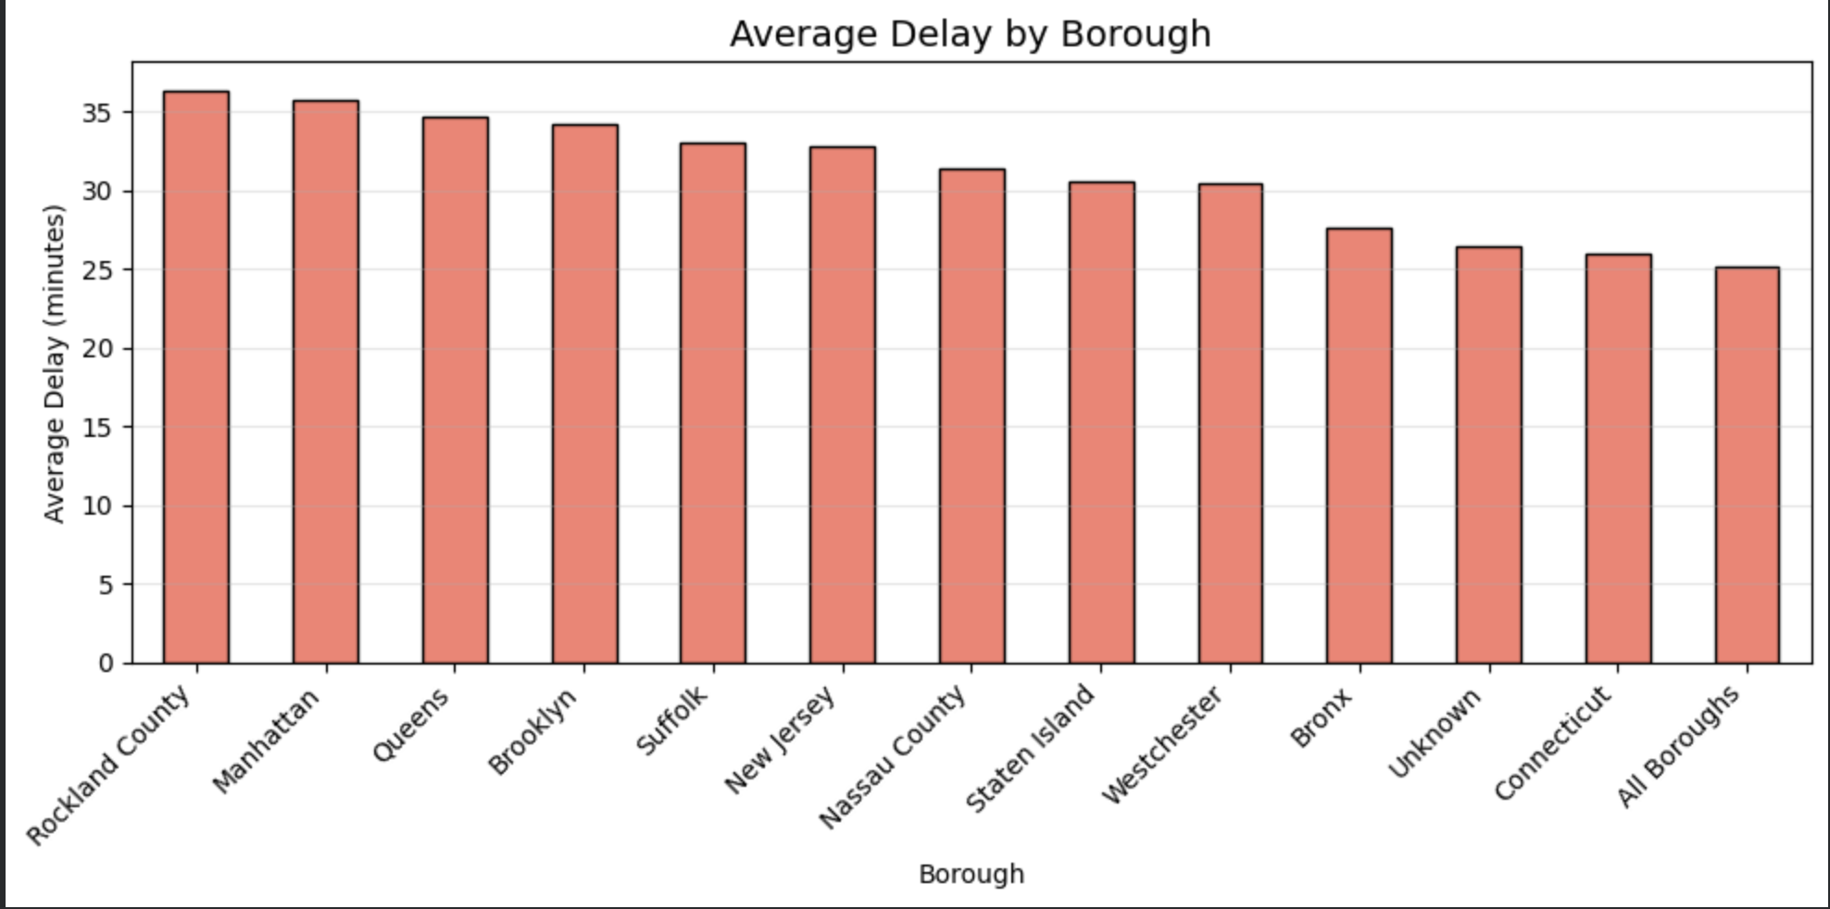

Slide 9
Further Steps of Delay-Predicting System
Step 1- A thorough detective style search, fill, tie lose threads and find real culprits to make a strong data starting point, marking it as a stepping stone for building this system.
Step 2- Make working systems which are able to predict these delays timely and correctly, avoiding dollar overflow due to delayed information.
Step 3- Employ these systems into a very small segment of New York city and find how effective are these systems working, eventually predict its potential when applied to larger network of schools.

Slide 10
Project Deliverables
Deliverable | Business Value
1. Clean Delay Dashboard | One trusted view of all past delays (by borough, time, vendor, reason)
2. Delay Prediction Tool | Forecast: “This route will be 25 minutes late” or “High risk of long delay”
3. Early Alert System (Prototype) | Auto-text to parents/schools when delay > 20 min is predicted
4. Vendor Performance Scorecard | Rank bus companies by delay frequency and severity
5. Action Playbook | “If prediction says X, do Y” – e.g., send backup bus, reroute, notify OPT

Slide 11
Possible risk’s
Building any system requires not just a Data expert but also a Subject matter expert. Any working system/machine built without joining these two segments (knowledge transfer from one to another), will lead to a failed system, loss of money, time and resources. To avoid such situation, its advisable to clearly plan resources under each department who’ll look after different stages of the project.

Slide 13
Executive Summary
With an estimate of 4 months and and 7 resources ( 1 project lead, 2 data analyst, 2 data scientist, 1 DevOps engineer and 1 IT support), this ‘live-radar’ should be up and running, predicting late bus delays before its occurrence. This live system should predict real time delays, alert parents and schools about estimated delay & reason of delay, held school vendors responsible for repetitive service disruptions. This system will help Office of Pupil Transportation to shift focus from observing disruptions to preventing disruptions.

